Slide 1
Module III Wind Energy
Sources and potentials, Evaluation of Wind Intensity, Topography
General Classification of Wind Turbines-Rotor Turbines, Multiple-Blade Turbines, Drag Turbines, Lifting Turbines
Toroidal Rotor Amplifier Platform (TARP)–Wind amplified rotor platform (WARP)
Generators and speed control used in wind power energy
SCIG and DFIG, Synchronous Generator-external magnetized, Synchronous Generator-permanent magnets
Speed control used in wind power energy, Fixed speed with capacitor bank, Rotor resistance control

Slide 2
Wind Energy: Sources
Wind energy is a converted form of solar energy.
Wind is the motion of air masses produced by the irregular heating of the earth’s surface by sun. These differences consequently create forces that push air masses around for balancing the global temperature or, on a much smaller scale, the temperature between land and sea or between mountains.
Wind energy is the kinetic energy associated with movement of large masses of air.
These motions result from uneven heating of atmosphere by the sun, creating temperature, density and pressure differences.

Slide 3
Wind Energy: Sources
Global Winds
Global winds are winds that occur in belts that go all around the planet.
Two major forces determine the speed and direction of wind on global basis.
Primary force for global winds is developed due to differential heating of earth at equator and Polar regions.
In the tropical regions there is net gain of heat due to sun rays, whereas in the Polar Regions there is net loss of heat.
Thus, earth’s atmosphere has to circulate to transport heat from tropics towards the poles.

Slide 4
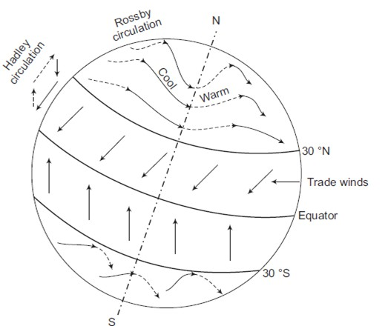
Wind Energy: Sources
Spinning of earth about its axis produces Coriolis force, which is responsible for deviation of air currents towards west.
Between 30°N and 30°S, heated air at the equator rises and is replaced by cooler air coming from north and south (Hadley circulation).
Between 30°N (/S) and 70°N (/S) predominantly western winds are found. These winds form a wavelike circulation, transferring cold air southward and warm air northward (Rossby circulation).

Slide 5
Local Winds
Localized uneven heating is responsible for local winds.
Local winds are produced due to two mechanisms
Differential heating of land surface and water bodies due to solar radiation
During the day, solar energy is converted to thermal energy on the land surface and thus quickly increases its temperature.
On water bodies it is partly consumed in evaporating water and only partly absorbed to cause an increase in temperature.
Land mass thus becomes hotter than water, which causes differential heating of air above them and cool and heavier air blow from water towards land.
At night, the direction of wind is reversed as the land mass cools more rapidly than the water.
Differential heating of slope on the hillsides and that of low lands.
The slope heats up during the day and cools down during night more rapidly than the low land

Slide 6


Evaluation of Wind Intensity
The energy captured by the rotor of a wind turbine is proportional to the cubic power of the wind speed
Wind power P,
Ke : kinetic energy
dm/dt : mass flow rate per second
v : moving air velocity
A : area swept by rotor blade
V :volume of air
⍴ :air density
(1)
(2)

Slide 7


Evaluation of Wind Intensity
The effective power extracted from wind is derived from the airflow speed just reaching the turbine, v1, and the velocity just leaving it, v2.
The number of blades must also be considered.
(3)
There is a difference in the kinetic energy in the wind speed just reaching and just leaving the turbine
Net wind mechanical power of the turbine is imposed by this kinetic energy difference
(4

Slide 8



Evaluation of Wind Intensity
Combining equations (3) and (4),
(5)
(6)
where is the power coefficient or rotor efficiency

Slide 9
Evaluation of Wind Intensity
If Cp is considered a function of v2/v1, the maximum of such a function can be obtained for v2/v1 = 1/3 as Cp =16/27 = 0.5926.
This value is known as the Betz limit, the point at which if the blades were 100% efficient, the wind turbine would no longer work because the air (having given up all its energy) would stop entirely after passing its blades.

Slide 10
Topography
The analysis of topography is very important when choosing a site.
This is an important point when mountainous locations are under consideration.
For those areas, the wind speed increases on the front side of the mountain and decreases on the opposite side.
In plane areas, the position of tree barriers should be observed with respect to the wind, as their proximity to the place chosen for turbine installation is critical.
There should be a maximum of free space between tree barriers and the power plant, to avoid any slowing down of the wind
With increased altitude, the movement of a wind draft takes a more complex form, due to different land shapes.
Thus, it is necessary to have a reasonable knowledge of the characteristics of the soil to be occupied
The roughness of the ground surface causes wind shear, which changes significantly with altitude

Slide 11
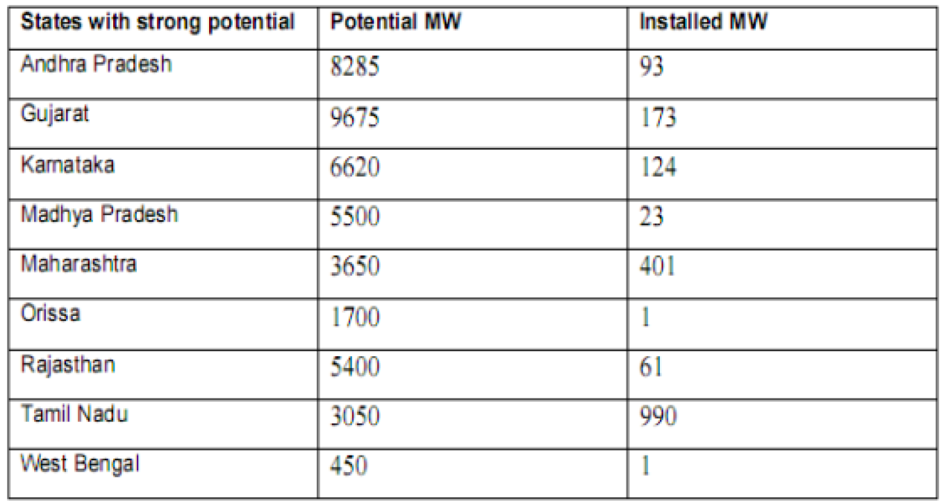
Potentials of Wind Energy
India has a vast supply of renewable energy resources. India has one of the world’s largest programs for deployment of renewable energy products and systems 3,700 MW from renewable energy sources installed.

Slide 12
Advantages of Wind Power
Wind power is an inexhaustible source of energy.
The wind is available freely and using modern technology it can be captured efficiently.
It does not create any type of environmental pollution.
The wind turbines require less space than the average power stations; thereby the land around wind turbines can be used for other useful purpose like farming etc.
When combined with solar electricity, it proves to be great for developed and developing countries to provide a stable and consistent supply of electricity.
Wind turbines can be used to produce electricity for remote areas, where other sources of energy are not available.
Wind energy can directly be used as mechanical energy.
Wind power is comparatively cost-effective among the available renewable sources of energy.

Slide 13
Disadvantages of Wind Power
The major disadvantage of wind power is the unpredictability. The winds are often uncertain and unpredictable and hence continuous supply of power cannot be obtained.
Only those areas are suitable for wind power where strong winds are expected for most of the time during a year.
Construction of wind farms generally requires large open spaces.
Most of the wind farms and wind turbines are located in remote areas where transmission lines are not available. Hence, it becomes a costly affair to lay long transmission networks to make use of the generated power.
Local wildlife and birds can get damaged due to wind blades.
Wind turbines create noise and disturbance in the nearby area.
The average efficiency of wind turbines is less as compared to conventional fossil fuel power plants.
The wear and tear of mechanical parts of wind turbines makes their maintenance costly.

